Slide 1
ANSY FC Streaming Policy & Process
V1.1 (Draft)
Dated: 20 Apr 21

Slide 2
The Player Pathway
FUNdamentals (U5-U8)
Foundation Phase
(U9-U11)
Youth Development Phase
(U12-U16)
Professional Development Phase
(U17-U23)

Slide 3
Streaming Model
FUNdamentals
Training is Mixed
Foundation Phase
Training is streamed but Age-Group Centred, teams should train at same venue & time as each other if possible.
Youth Development Phase
Training is streamed and teams may become more independent of each other now.
Teams are Mixed
During U8 season communication on streaming is shared with Players & Parents to allow time for discussion.
Players may move teams at any time during season.
Players assessed pre-season and streamed.
Players assessed pre-season and streamed.
Mid-season assessment with changes made during Xmas break.
U15/U16 minimal movement between streams.
Professional Development Phase
U17 - Streamed teams continue if sufficient players.
U18 – Probably only sufficient players to maintain a single U18 team. All players will be registered for Swifts.
U19 – U23 Andover NS Swifts

Slide 4
“Streaming” – WHY?
To allocate players to teams according to the level of challenge they require at any given stage in their football journey.
This is not to produce winning teams, but to enable players to be the “Best they can be” which will mean different things for different players.
Maximise Coaching Benefits - Ensures Coaches are able to design training sessions relevant to a team’s collective ability, this will in turn maximise the benefit and enjoyment players receive in their session.
Maximise Competitiveness - From U8 some Leagues stream their divisions meaning a mixed-ability team could compete against teams of “higher” ability and struggle therefore risking their enjoyment of the game. Likewise “higher” ability teams do not learn much from winning every week with little or no challenge.
Personal & Social Development - It presents an opportunity for players to play with others in their age-group that they maybe haven’t before. Imagine a player who is struggling in a team is moved into a team of similar ability and goes from finding playing a daunting experience with little opportunity of success to being more INVOLVED, more SUCCESSFUL, enjoying more POSITIVE moments…this can do wonders for a players confidence and spur them on to develop further.

Slide 5
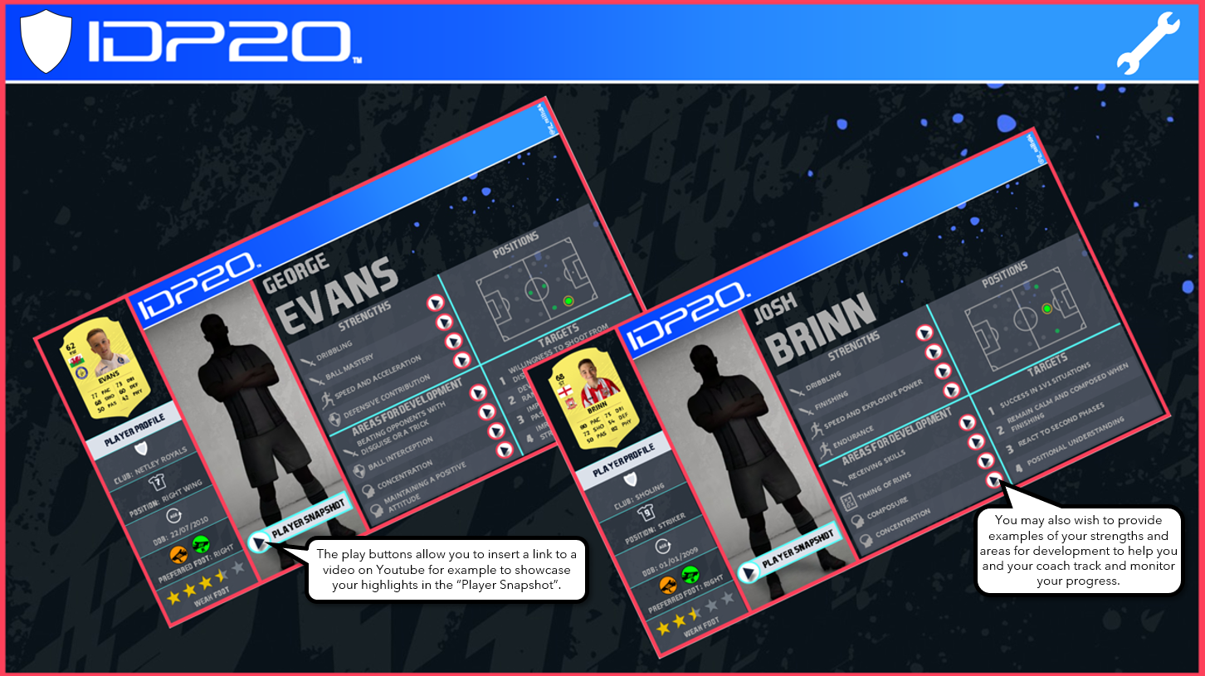
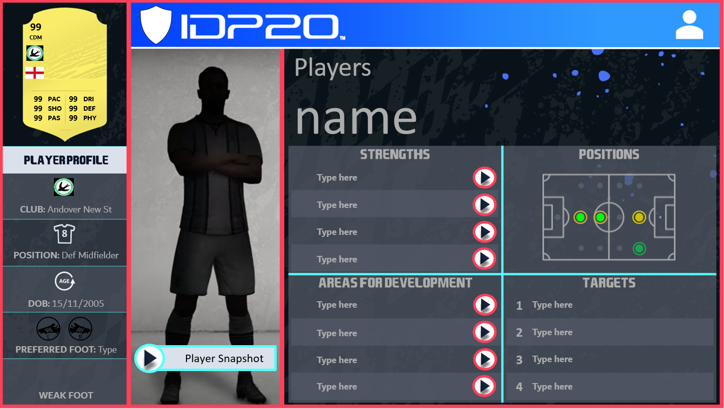
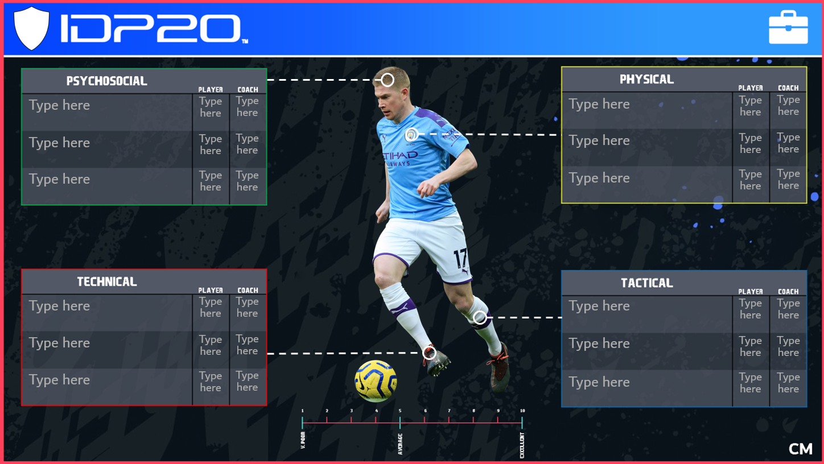
HOW?
An agreed Player Development Plan will be used throughout the Club when assessing what level of challenge a player would benefit from. This will ensure players are assessed on criteria that is in line with the Club’s overall Ethos and Philosophy and the criteria remains consistent throughout their football journey.

Slide 6
WHO & WHEN?
U8 Season;
Halfway point of season - Communication to Players & Parents re; Streaming Guidelines & Methodology for next season.
U9 Season;
Pre-Season – Players assessed and streamed for the first time according to Coach observations of previous season and this pre-season.
U9/U10/U11;
Prior to each new season players are assessed during pre-season and streamed for the forthcoming season.
Players assessed continually throughout season and moved between teams accordingly.
Players may move teams more than once during a season.
U12/U13/U14;
Players are now also assessed at the halfway point during the season (December)
Need to move players between teams is possibly reducing now.
Players can still move teams at any time during the season

Slide 7
U14/U16;
Player movement between teams should by now be limited to Pre-Season and December “window”
Movements outside of these “windows” is permitted but must be agreed by Age-Group/Phase Lead.
U17/U18;
Players assessed Pre-Season and allocated teams
Players MAY still be moved during “December” window.
Player movement between teams now limited to Pre-Season and December “windows” unless exceptional circumstances.

Slide 8
Code of Conduct for Player Streaming (Non-negotiables)
Player WELFARE is paramount at all times.
COMMUNICATION with Players and Parents will be transparent, consistent and given in good time.
Coaches, Managers and Age-Group Leads will WORK TOGETHER to;
Deliver Player Streaming in line with Club ethos of INCLUSION & DEVELOPMENT and in the knowledge that this is a sensitive topic for Players and Parents alike.
Ensure lines of COMMUNICATION are always open to discuss concerns.
Conduct the Streaming process with RESPECT for all parties involved.

Slide 9
Desired Outcomes of Player Streaming
Players receive appropriate level of challenge and support at every step of their journey both in matches/trophy events and coaching sessions.
Players maintain and develop their love of the game through learning new skills while experiencing success regularly enough to encourage them to push themselves.
Increases ability of our teams to be competitive opposition, aiding the development of the players we compete against in trophy events and League matches at older age-groups.

